Slide 1
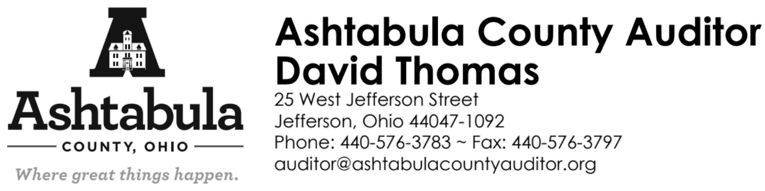
Woodlands CAUV and Ohio Forestry
David Thomas, Ashtabula County Auditor
February 24, 2022 6pm
Notes:
DT

Slide 2
Agenda
Non-Business Tax Credit Issue
CAUV Overview
Commercial Woodlands CAUV
Ohio Forest Tax Law (OFTL) Overview
Programs in Action- hearing from Ohio Division of Forestry
Environmental Quality Incentives Program (EQIP)
Comparing CAUV Forestry & OFTL
Questions from you!
Notes:
DT

Slide 3
Non-Business Tax Credit Issue
ORC 319.302 Reduction of remaining taxes.<http://codes.ohio.gov/orc/319.302v1>
(A) (1) Real property that is not intended primarily for use in a business activity shall qualify for a partial exemption from real property taxation. For purposes of this partial exemption, "business activity" includes all uses of real property, except farming; leasing property for farming; occupying or holding property improved with single-family, two-family, or three-family dwellings; leasing property improved with single-family, two-family, or three-family dwellings; or holding vacant land that the county auditor determines will be used for farming or to develop single-family, two-family, or three-family dwellings. For purposes of this partial exemption, "farming" does not include land used for the commercial production of timber that is receiving the tax benefit under section 5713.23<http://codes.ohio.gov/orc/5713.23> or 5713.31<http://codes.ohio.gov/orc/5713.31> of the Revised Code and all improvements connected with such commercial production of timber.
-Can Appeal through the Board of Revision if 50%+ of parcel value is non-woodland.

Slide 4
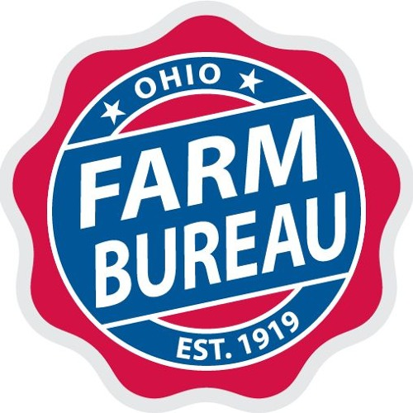
Farm Bureau Advocacy
Mandy Orahood: Organization Director Northeast Ohio Counties Farm Bureau
(440) 426-2195
aorahood@ofbf.org

Slide 5
CAUV
What is CAUV? Use Based Valuation
    A program for farmland devoted exclusively to commercial agriculture may be valued according to its current use rather than at its “highest and best” potential use.
    This provision of Ohio law is known as the Current Agricultural Use Value (CAUV) program. By permitting values to be set well below true market values, the CAUV normally results in a substantially lower tax bill for working farmers.
Notes:
HH

Slide 6
Commercial Woodlands CAUV
Initial Application
Must be filed with the county auditor’s office after the first Monday in January and before the first Monday in March.
Need:
  • Forestland is 10 or more contiguous acres that are devoted exclusively to the commercial production of timber.
  • If the farmland is devoted exclusively to commercial agricultural use, adjacent
  non-commercial forestland may qualify under certain circumstances.
  • Landowner must have a forest management plan that they will follow.
  • Submit the following to your County Auditor:
      - Completed CAUV Initial application
    - Copy of the forest management plan
    - One-time application fee of $25
Notes:
HH

Slide 7
Notes:
HH

Slide 8
Commercial Woodlands CAUV
Commercial Forestry CAUV Inspections
Nathan Paskey from Soil and Water as well as Sam Holley, owner of S Holley Lumber Co. LLC inspect all of our forestry properties every few years depending on where the landowner is on their forest management plan. All new applicants will be inspected the first year of applying.
  Nathan Paskey
  Ashtabula Soil & Water Conservation District
  39 Wall Street
  Jefferson, OH 44047
  440-576-4946
  ashtabulaswcd@gmail.com
  www.ashtabulaswcd.org
  Sam Holley
  S Holley Lumber Co. LLC
  440-636-3040
  sam@sholleylumber.com
Notes:
Nate

Slide 9
Commercial Woodlands CAUV
Commercial Forestry CAUV Renewal
Renewals are sent out every year in January, along with a worksheet that the land owner is required to complete. This worksheet certifies that the property owner has completed a yearly inspection and any necessary maintenance outlined in their forest management plan. Renewals should be in by the first Monday in March.
Notes:
HH

Slide 10
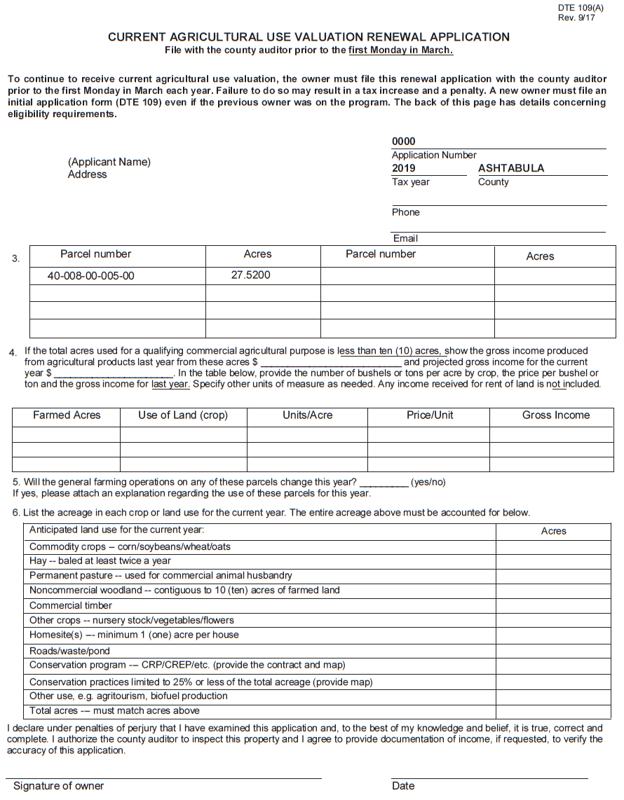
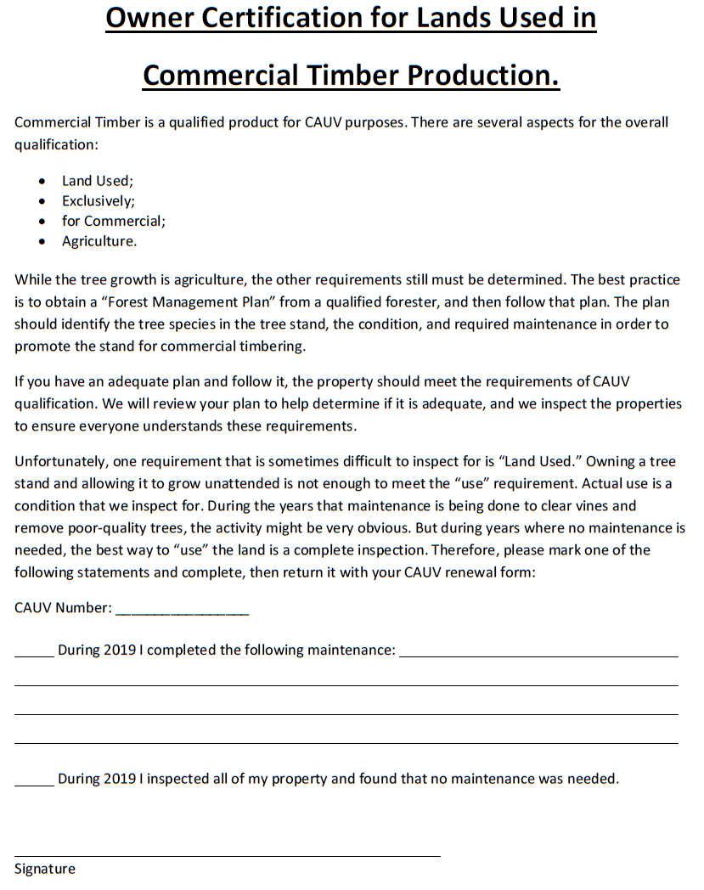
Notes:
HH

Slide 11
Commercial Woodlands CAUV
Woodlands CAUV Benefits
Provides a tax relief for landowners and helps you manage your woods to make it more profitable down the road. Could save 60-70% on your taxes, that savings is based on the soils on your property that the state determines.
Woodlands CAUV penalties
If the land use changes or if the landowner decides to withdraw his or her land from CAUV, there is a recoupment penalty equal to the tax savings for the preceding 3 years.
Notes:
HH

Slide 12
Ohio Forest Tax Law (OFTL)
Need for Qualifications:
Forestland must be 10 or more contiguous acres
Property boundary lines and/or forest boundary lines must be clearly marked prior to examination and those markings continuously maintained.
Timeline:
You can apply at any time
Submit the following to your service forester:
  Completed application
  Forest management plan (ODNR does not write plans anymore)
  3 copies of an aerial photograph of your property
  Copy of your most recent tax bill
Notes:
Luke

Slide 13
Ohio Forest Tax Law (OFTL)
OFTL Checks
At RANDOM, the Division of Forestry will inspect certified forestland to ensure compliance with the program and with the forest management plan.
OFTL Renewal
Self Certification will be mailed every 5 years to the landowner
OFTL Benefits
Provides a 50% reduction in the local tax rate on forestland
OFTL penalties
There are no penalties to withdrawal
•However, some changes in ownership, deed changes, acreage increase/decrease, poor land management, or bad timber harvesting can lead to a cancellation
Notes:
Luke

Slide 14


Some thoughts from John
Northern Service Forestry Coordinator:
  John Kehn
  11800 Buckeye Drive
  Newbury, OH 44065
  614-512-0271 mobile
  John.kehn@dnr.state.oh.us
  Forestry.ohiodnr.gov
Service Forester:
  Jason Van Houten
  11800 Buckeye Drive
  Newbury, OH 44065
  614-309-6096
  Jason.VanHouten@dnr.state.oh.us
Environmental Quality Incentives Program
Notes:
Luke Walters

